Slide 1
ESHAN COLLEGE OF ENGINEERING MATHURA
ER. SHAILESH KUMAR
ASST. PROFESSOR
DEPARTMENT OF CIVIL ENGINEERING

Slide 2
Modeling Real Life Problems
Any physical/mechanical model is simple a caricature of a real-world problem.
Such a model is our way of understanding of real-world in as simple and tractable way as possible.
Allows us to calculate forces/etc., which can then be re-mapped to the real problem.
The real skill is to remove unwanted flab, and get a bare-bones model, which gives a quick and reasonably accurate solution.

Slide 3
Example-1: Roof Truss

Slide 4
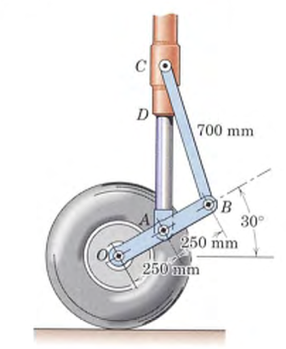
Another Example: Aircraft Landing Gear

Slide 5
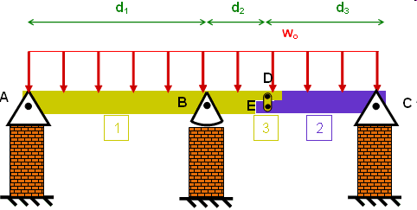
Example 3 Bridge

Slide 6
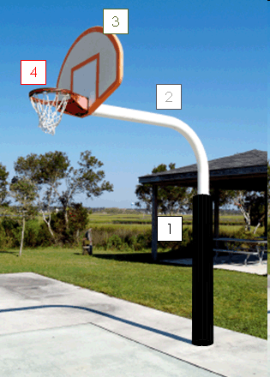
Example 4 Simple basket-ball pole

Slide 7
Example-5 Ladder Climbing

Slide 8
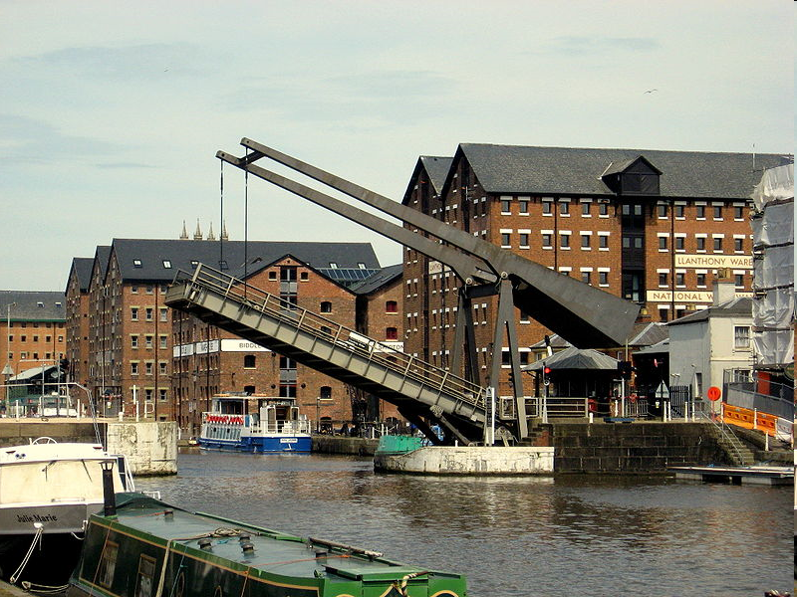
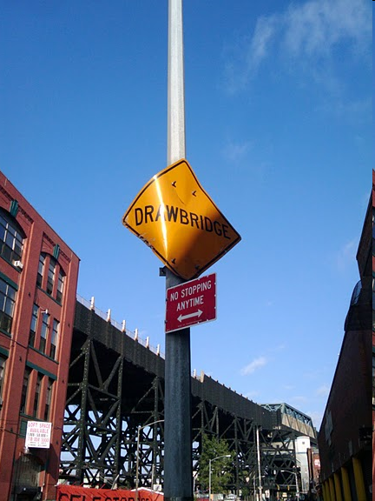
Example-5 Draw-Bridge

Slide 9
Vector Addition: Procedure for Analysis Parallelogram Law (Graphical) Resultant Force (diagonal) Components (sides of parallelogram)
Force Systems Cable Tension P Force: Magnitude (P), direction (arrow) and point of application (point A) is important Change in any of the three specifications will alter the effect on the bracket. Force is a Fixed Vector In case of rigid bodies, line of action of force is important (not its point of application if we are interested in only the resultant external effects of the force),

Slide 10
External effect: Forces applied (applied force); Forces exerted by bracket, bolts, Foundation (reactive force) Internal effect: Deformation, strain pattern – permanent strain; depends on material properties of bracket, bolts, etc.

Slide 11
Moment of a Force Principle of Transmissibility Any force that has the same magnitude and direction as F, is equivalent if it also has the same line of action and therefore, produces the same moment.

Slide 12
THANK YOU

